Slide 1
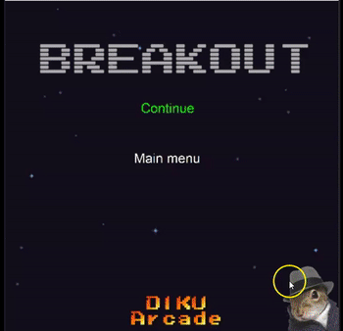
SU 2022
Examination Presentation
Aditya Fadhillah

Slide 2
Introduction
Breakout game
3 deliverables
Load text file maps into game levels
Block entities
A moveable player
A moveable ball
A state machine
Points
Special block type
Winning and losing
Game over
Power-up blocks and effect
10 main implementations
Code C#
VisualStudio Code
Notes:
We as a group have been assigned an implementation of the Atari game from 1976 called Breakout.
This assignment has taken place over three deliverables, and a final exam deliverable. This deliverables build upon each other, as an iterative process.
These 10 implementations are the main implementations that we are required to have in our game.
As seen above the deliverables starts with the foundation of the game and later, we add more and more complex implementation into it

Slide 3
Design
Design Patterns
Builder pattern (LevelLoader)
Singleton pattern (GameState)
Mediator pattern (GameBus)
State pattern (StateMachine)
SOLID-Principles
Single Responsibility
Open/Closed
Liskov Substitution
Interface Segregation (IGameState)
Dependency Inversion (IGameEventProcessor)
Low coupling & high cohesion
Increase maintainability
Notes:
S - Hver klasse skal fokusere på en enkelt opgave ad gangen. Alt i klassen skal være relateret til det enkelte ansvar (LevelLoader)
O - Enhver ny funktionalitet bør implementeres ved at tilføje nye klasser og metoder i stedet for at ændre de nuværende eller eksisterende (Lives)
L - Det betyder, at inheritor skal kunne udskiftes med deres inherited typer. (Entity)
I - En klasse bør kun udføre handlinger, der er nødvendige for at udføre sin rolle. (Interface – new Block)
D - Kan afbildes som to forskellige klasser, der abstrakt kan interagere med hinanden ved at bruge interface. (IGameEvenntProcessor)

Slide 4


Work process
Extreme Programming (XP)
Documentation (OverLeaf)
LiveShare (VisualStudio)
GitHub
New versions often
Refactoring
Continued integration
Deliverables every 2 week
Pair Programming
Client interaction (feedback)
Tests before release

Slide 5
Test
56 total test cases
Low statement coverage (C0)
Low branch coverage (C1)
Unit testing
White-box testing
Play testing

Slide 6
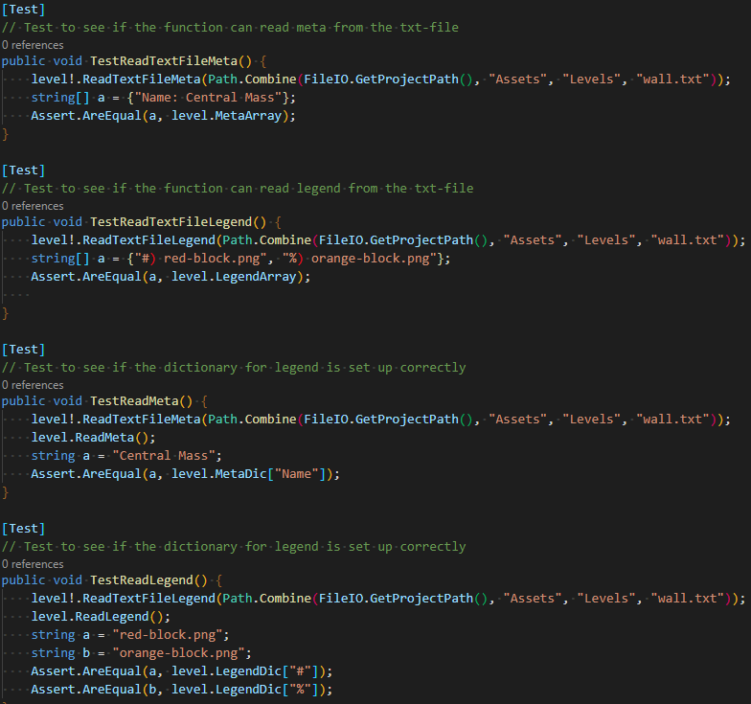
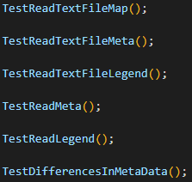
Test - LevelLoader
Unit testing
White-box testing

Slide 7
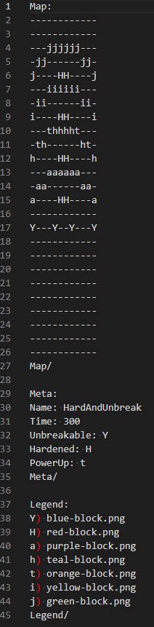
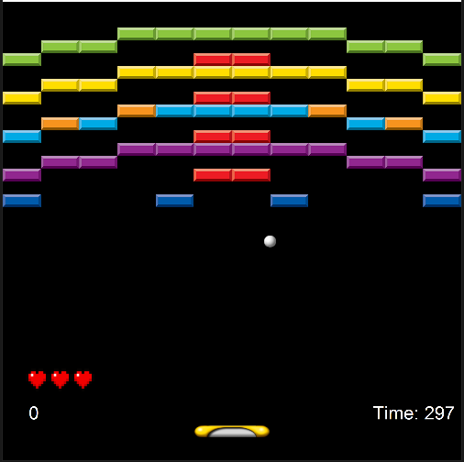
Test - LevelLoader
Unit testing
White-box testing
Play testing

Slide 8
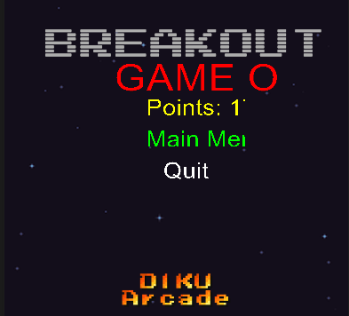
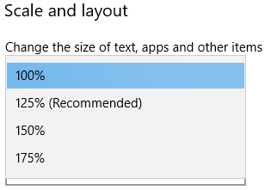
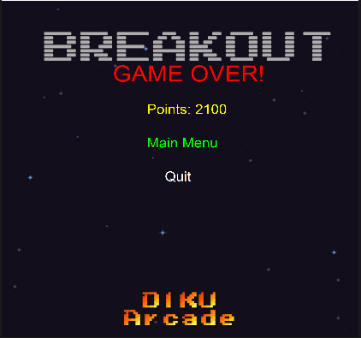
Play testing
Visual bugs
Corrects position of object

Slide 9
Refactoring
Essential in Extreme Programming
Improve design
Easier to understand
ReadMap() in LevelLoader

Slide 10
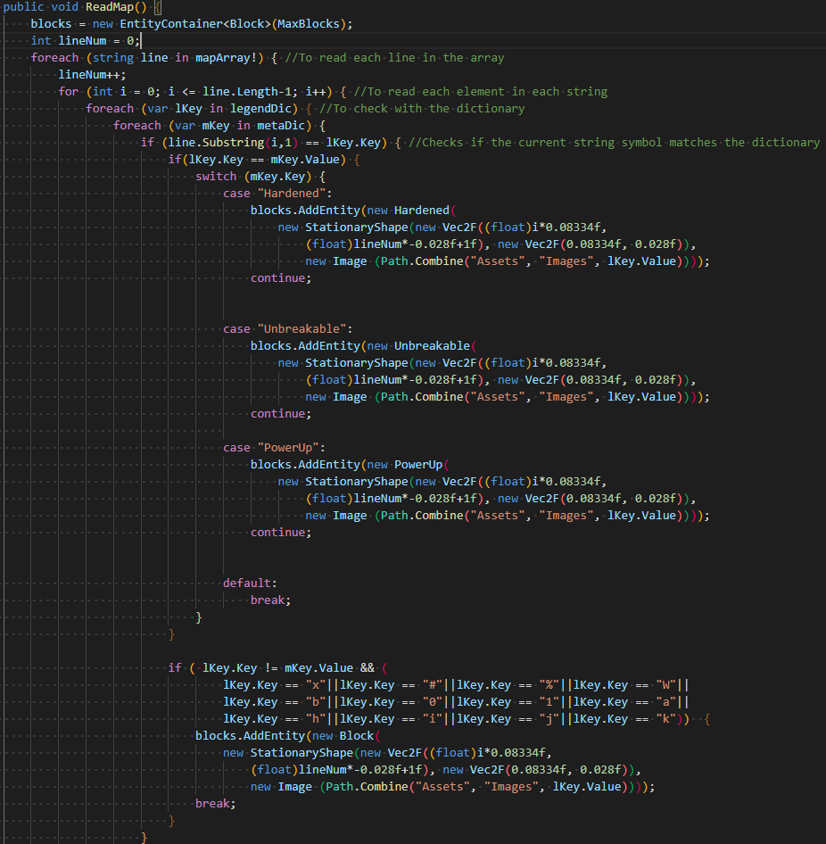
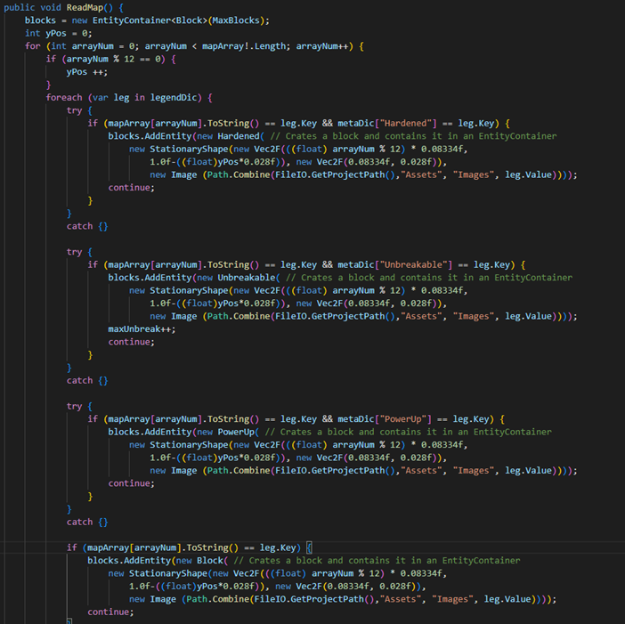
Refactoring

Slide 11
Refactoring
Less Hard Code (+Code Quality)
Defensive programming

Slide 12
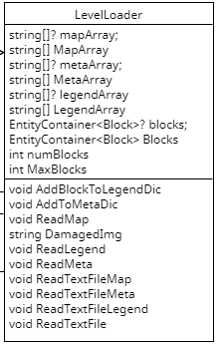

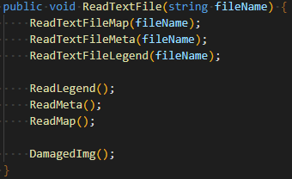
Design of LevelLoader
Builder Pattern
Single Responsibility Principle
High cohesion

Slide 13
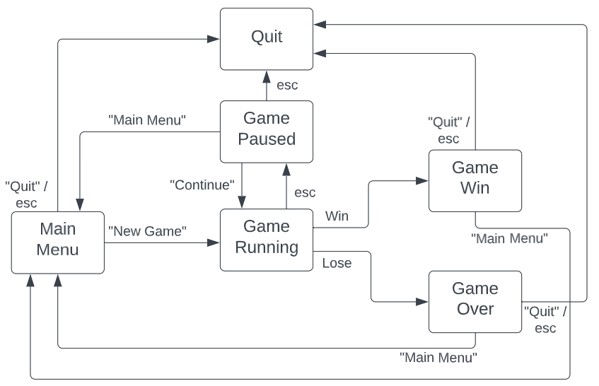

Design of GameState
Singleton Pattern
Open/Closed Principle
High coupling
Notes:
Singleton pattern – Kun en instance, global access
High coupling - En ændring ét sted kan have ukendte virkninger andre steder

Slide 14
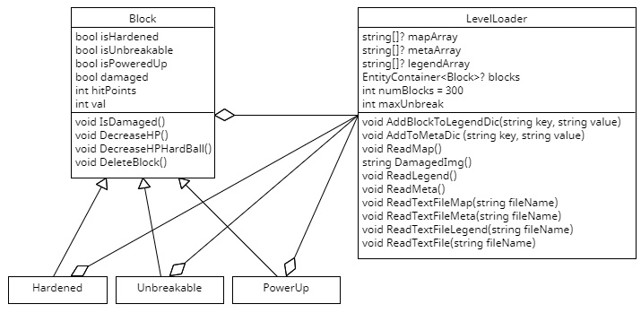
Design of Block and possible redesign of it
Single Responsibility Principle
Open/Closed Principle
High coupling

Slide 15
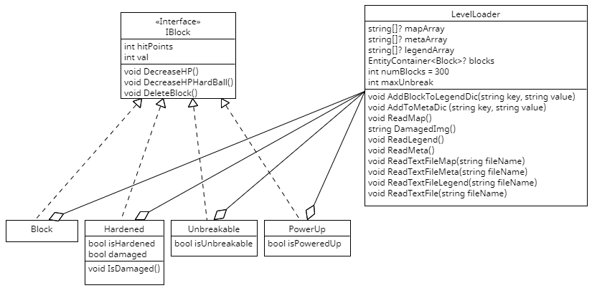
Design of Block and possible redesign of it
Abstract Factory Pattern
Open/Closed Principle
Interface Segregation Principle
Class Adapter Pattern
Low coupling
Notes:
Abstract Factory - er et designmønster, der lader dig producere familier af relaterede objekter uden at specificere deres konkrete klasser.

Slide 16
Conclusion
A game that runs as expected
Meet all the requirements (for the most part, speed of ball)
Implemented all the main implementations
Different lifecycle method (scrum method)
More testing

Slide 17
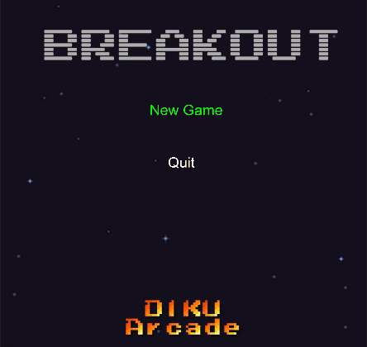
Gameplay

